Slide 1



NATURAL LANGUAGE PROCESSING PROJECT TRINABH SHRIDHAR -200139

Slide 2

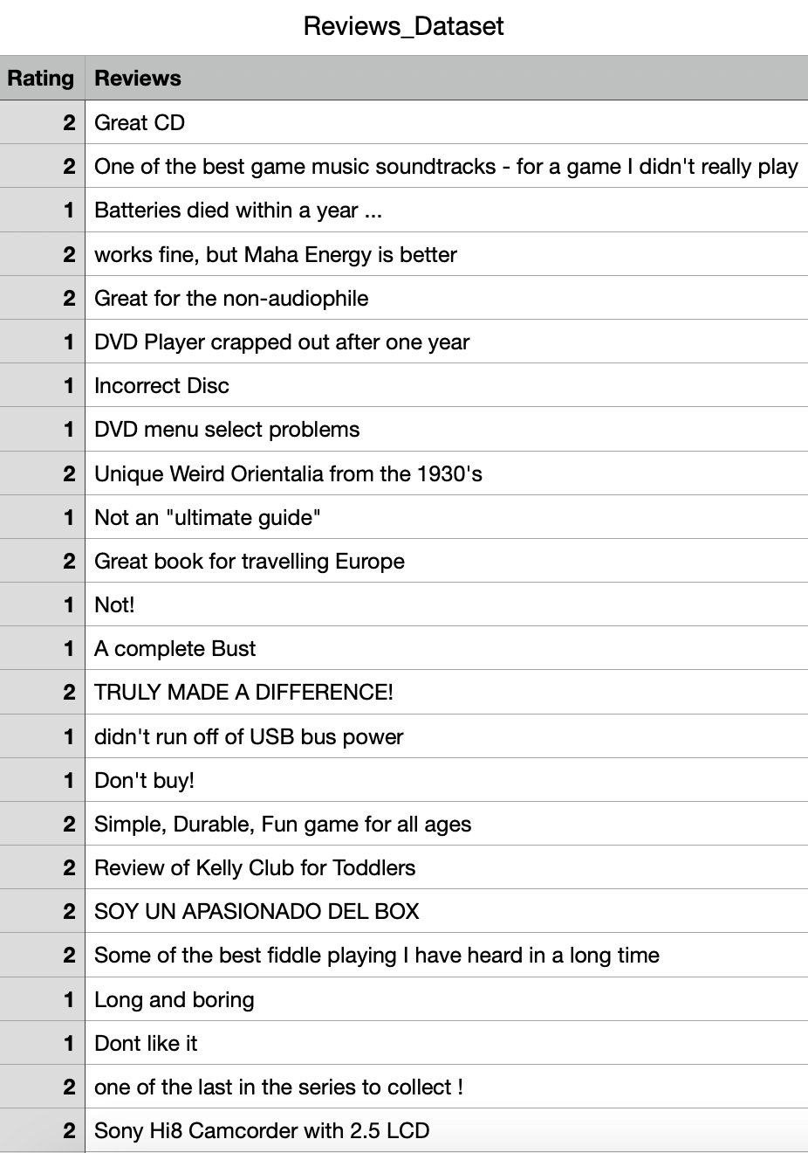
ABOUT THE DATASET
Product reviews dataset with 2 columns and 10,000 rows.
The columns Include Ratings and Reviews.

Slide 3

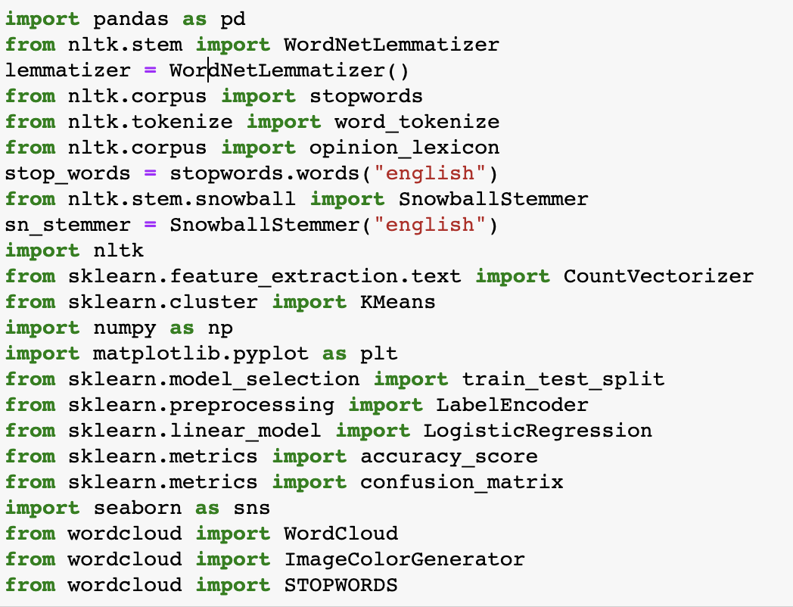
INSERTING NECESSARY LIBRARIES
Inserting all the necessary libraries for the working of the codes.

Slide 4
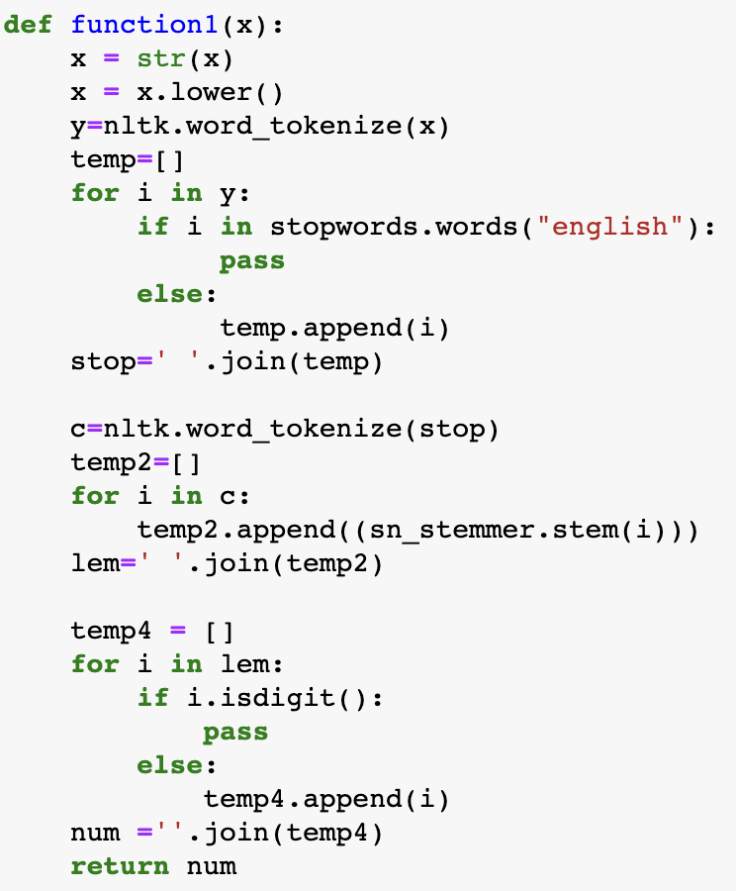
DATA CLEANSING
Here we type the 1st function for cleaning the reviews text into better understandable text by:
Tokenizing the words
Removing the stopwords.
Stemming the words.
Removing the numbers.

Slide 5
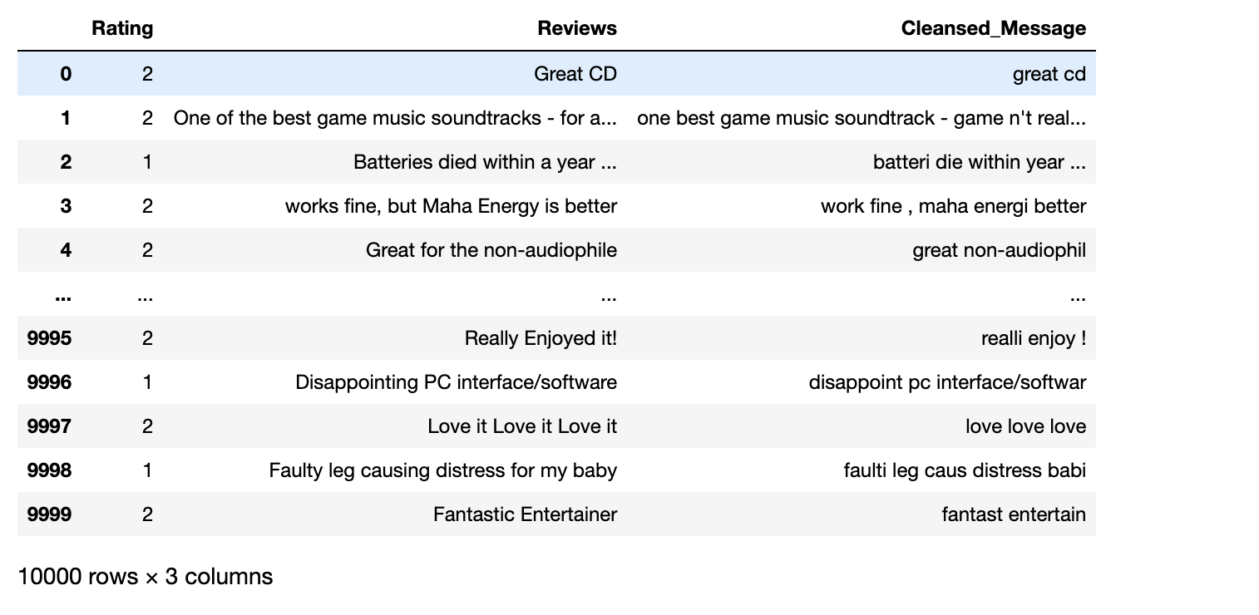
CLEANSED REVIEWS TEXT

Slide 6
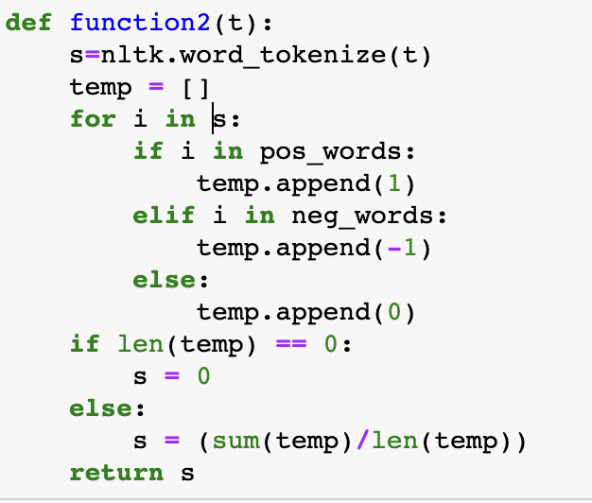
CALCULATING THE SENTIMENT SCORES
Importing the Positive and Negative Words Dictionaries through Opinion Lexicon Library.
Typing 2nd function which inputs +1 for each positive word, -1 for each negative word and 0 if none.
Returning or giving the average between sum of all the words in a list (after converting it into +1,-1, 0) and total number of words in the list.

Slide 7
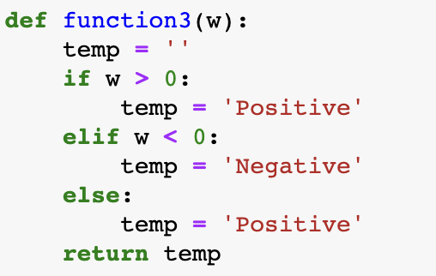
CATEGORIZING THE SENTIMENT SCORES
Typing the 3rd function which inputs different categories for different number.
‘Positive’ for sentiment score over 0.
‘Negative’ for sentiment score below 0.
‘Positive’ for sentiment score equal to 0.

Slide 8
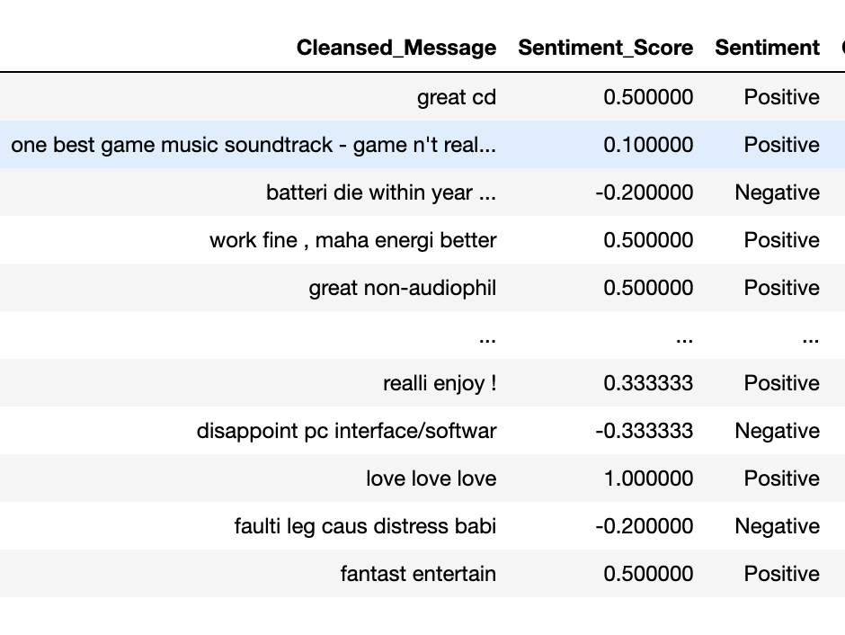
SENTIMENT SCORES AND SENTIMENT CATEGORY

Slide 9
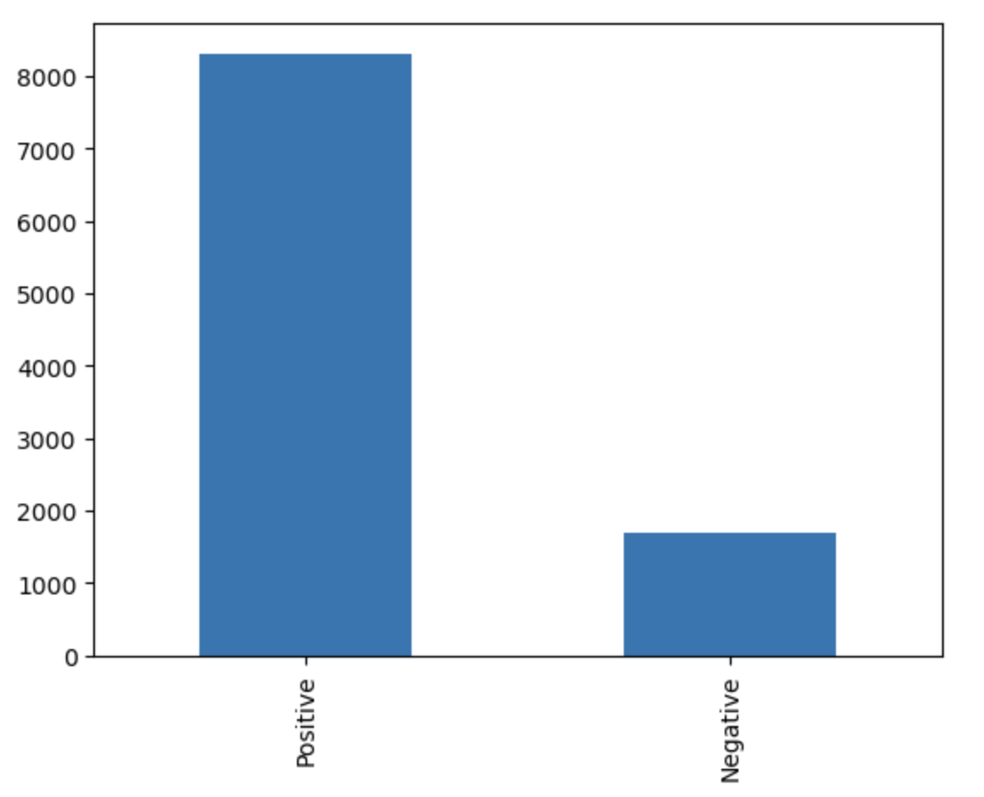
BAR PLOT
Bar Plot for total number of Positive and Negative sentiments.
Positive - 8308
Negative - 1692

Slide 10
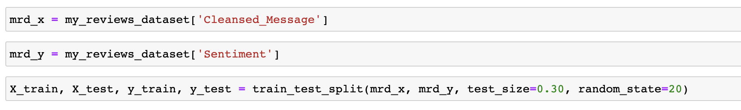
EVALUATING MODEL’S ACCURACY
Evaluating model’s accuracy by creating ML Model between Cleansed Message and Sentiment.
Test size is equal to 30% of the cleansed message.
Random state is 20, can be any static number to keep the results same on running the code again and again.

Slide 11
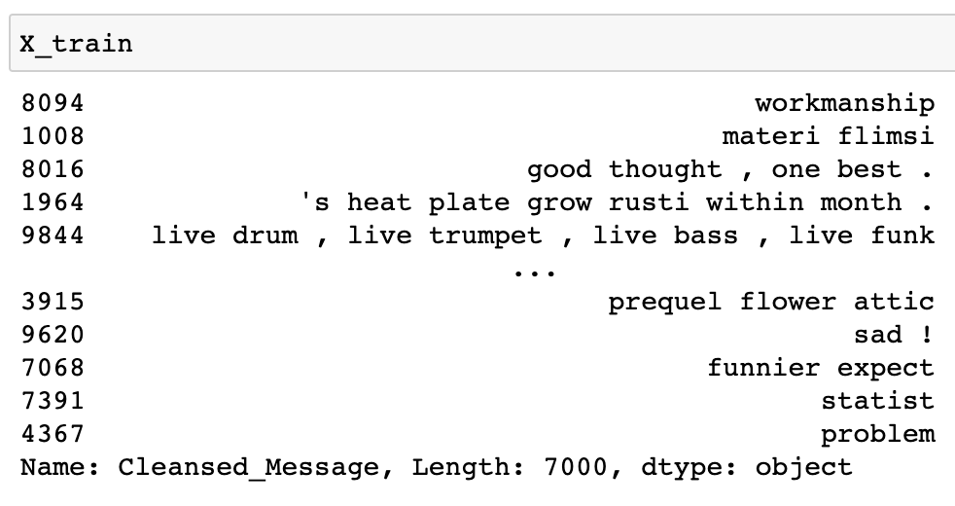
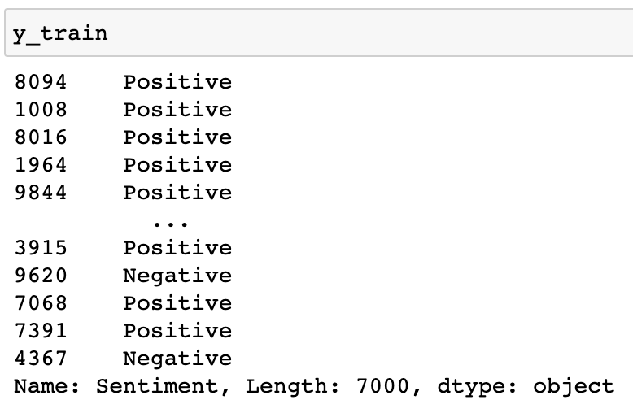
X TRAIN
Y TRAIN

Slide 12
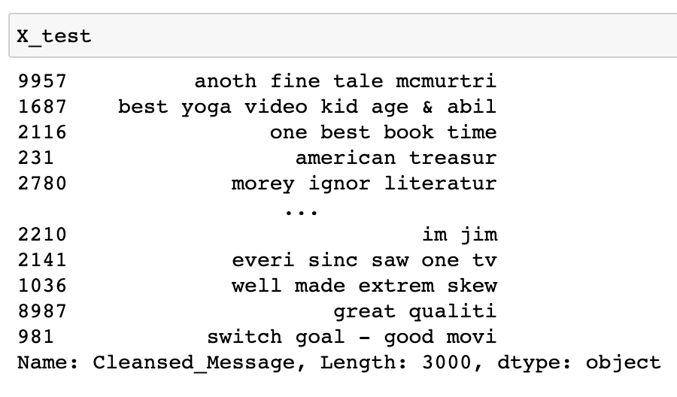
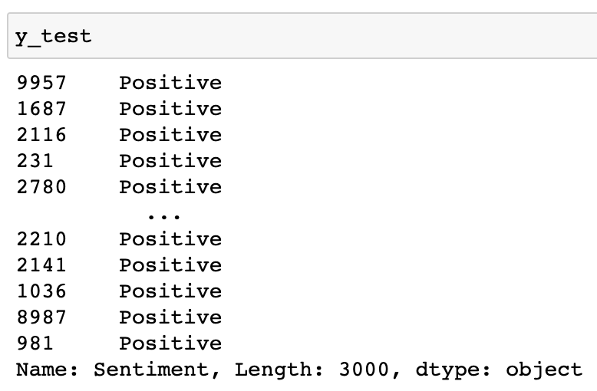
X TEST
Y TEST

Slide 13
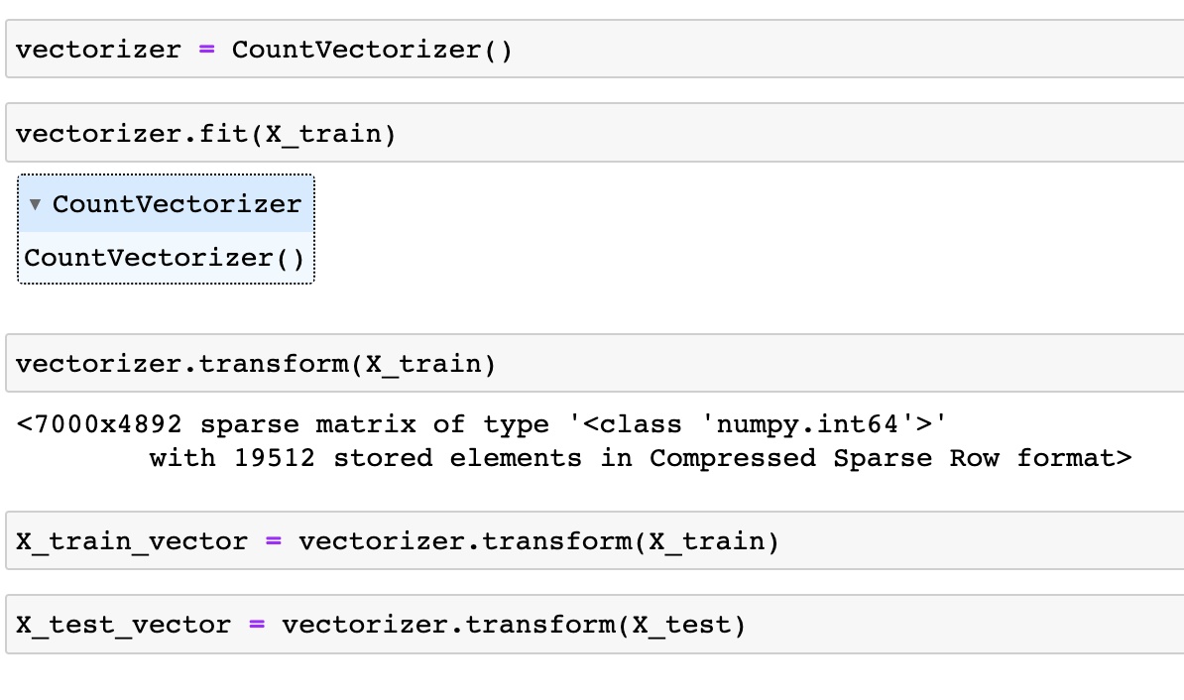
VECTORIZING
Applying Count Vectorizer to convert text to numerical data in terms of how many times it is appearing.
Applying Vectorizer to X train and X test.

Slide 14
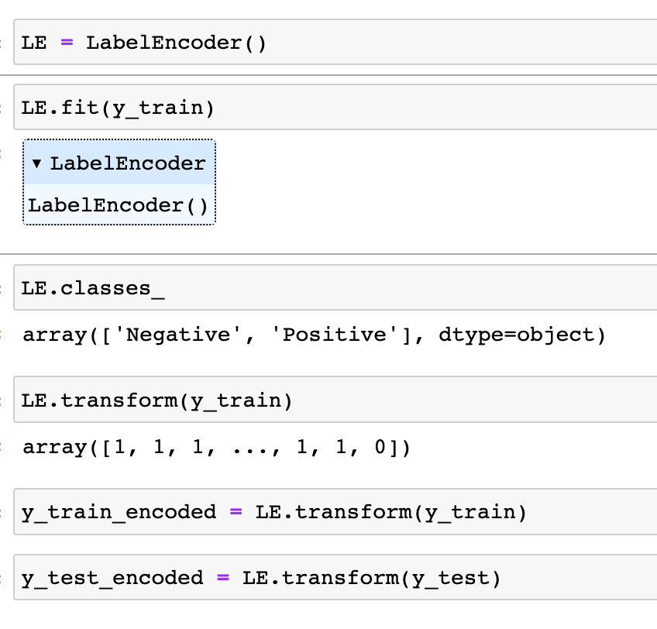
LABEL ENCODING
Applying Label Encoder which takes a categorical column and converts it to numerical values.
Applying Label Encoder on Y train and Y test.

Slide 15
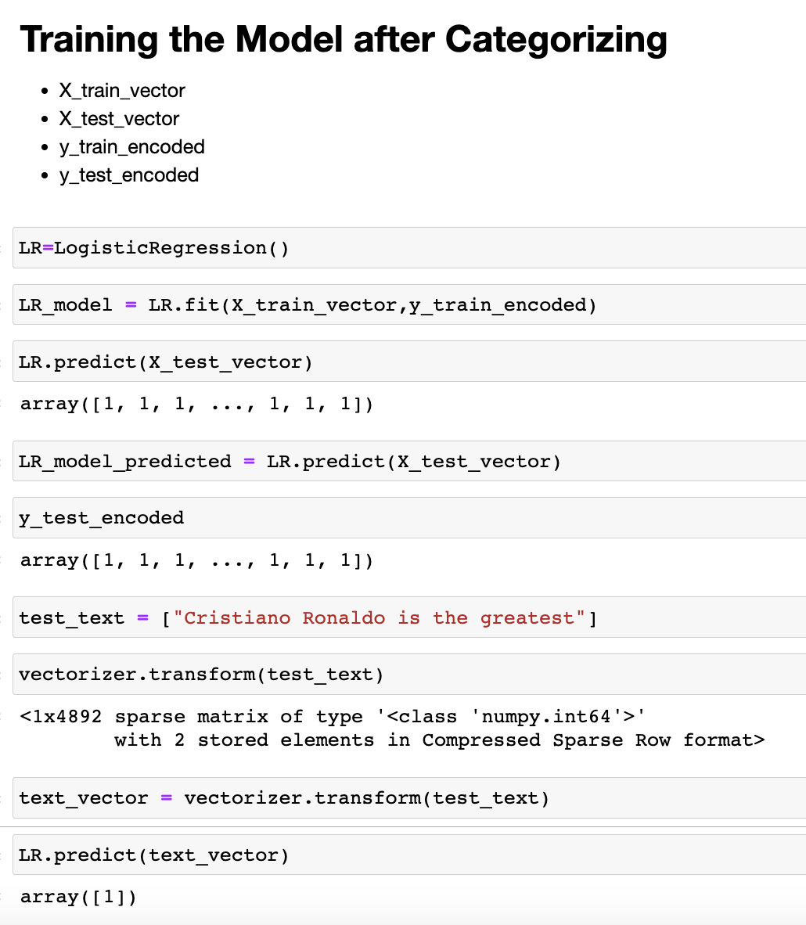
TRAINING THE MODEL AFTER CATEGORIZING
Applying Logistic Regression to predict the probability of a categorical dependent variable.
In logistic regression, the dependent variable is a binary variable that contains data coded as 1 (yes, success, etc.) if the array is positive or 0 (no, failure, etc.) if the array is negative.

Slide 16
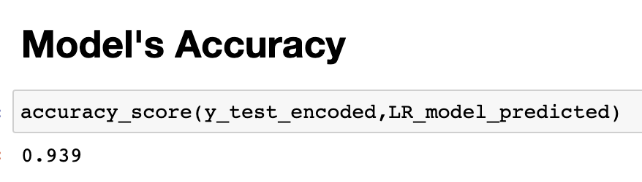
MODEL’S ACCURACY
Model’s Accuracy is 94%

Slide 17
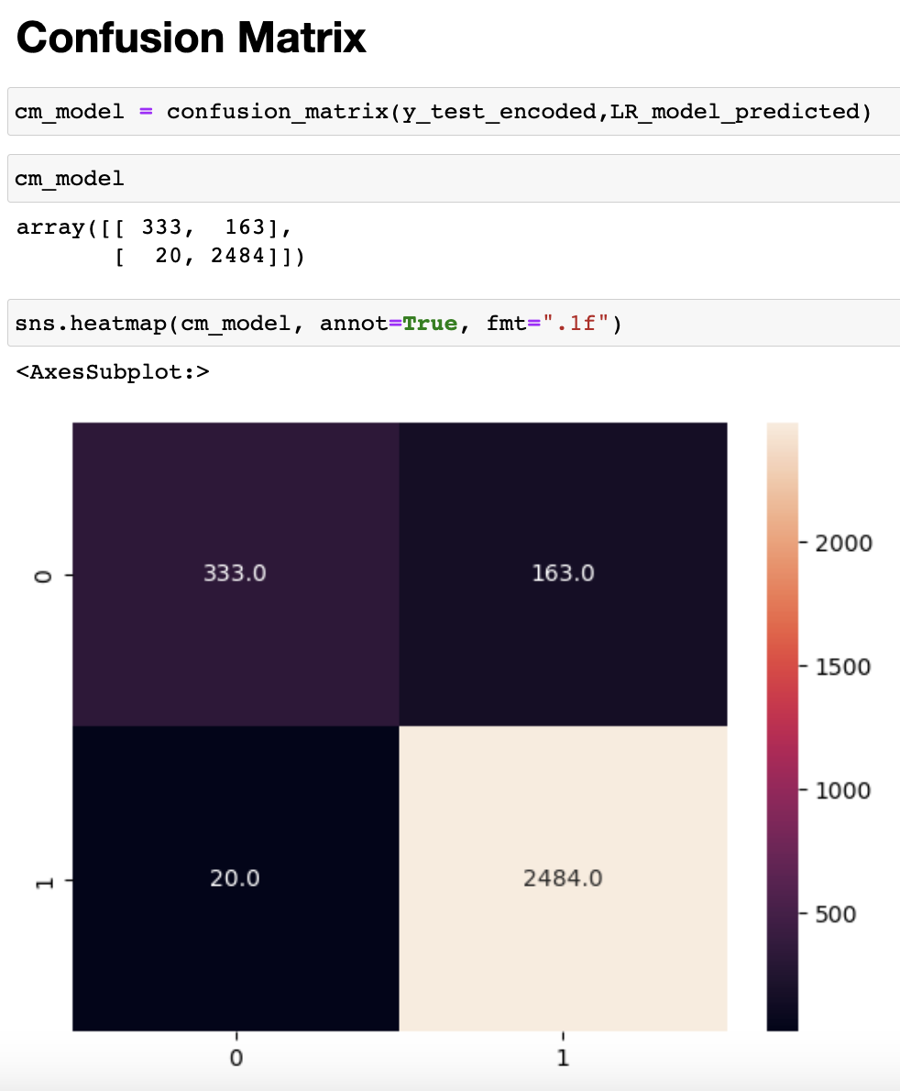
CONFUSION MATRIX
Applying Confusion Matrix to see total number of true positive, false positive, false negative and true negative.
Converting Confusion Matrix into Heatmap which tells:
True Positive (top left) – 333
False Positive (top right) – 163
False Negative (bottom left) – 20
True Negative (bottom right) – 248
The most frequency is in True Negative.

Slide 18
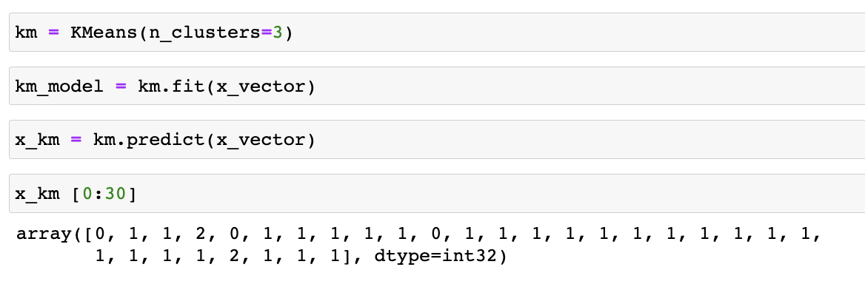
CLUSTERING
KMeans Clustering to group similar kinds of items in form of clusters.
Number of clusters chosen are 3

Slide 19
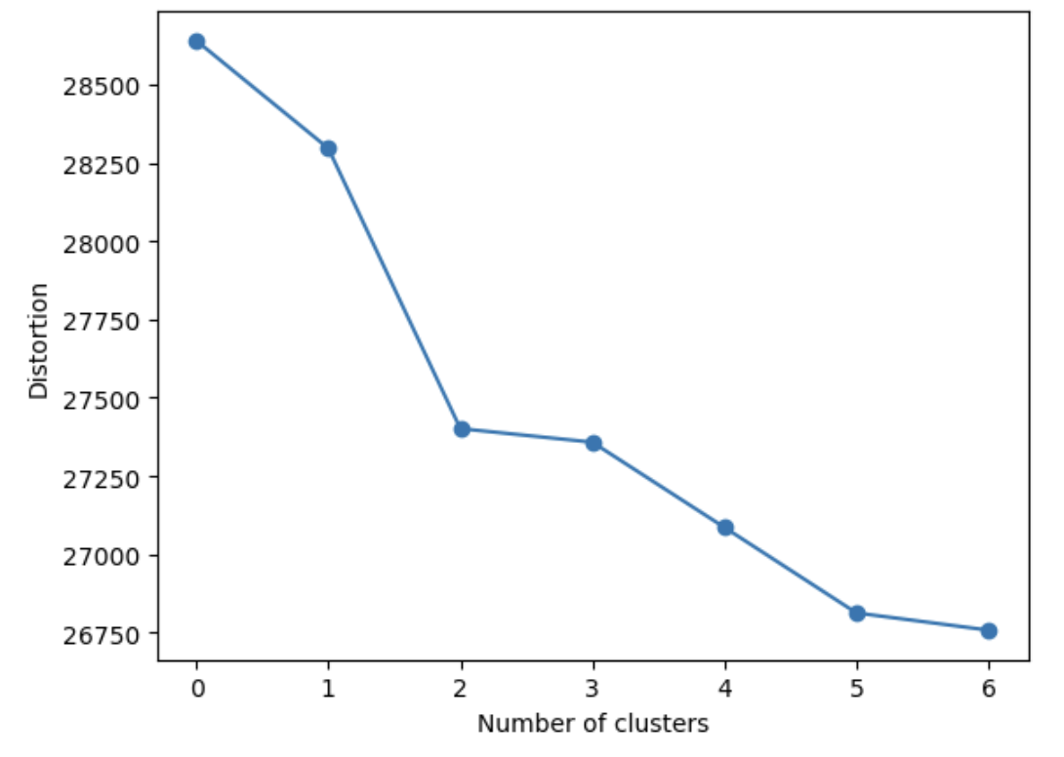
ELBOW GRAPH
It shows number of clusters you should keep.
to decide how many clusters to build dependent on the difference in their intensity.

Slide 20
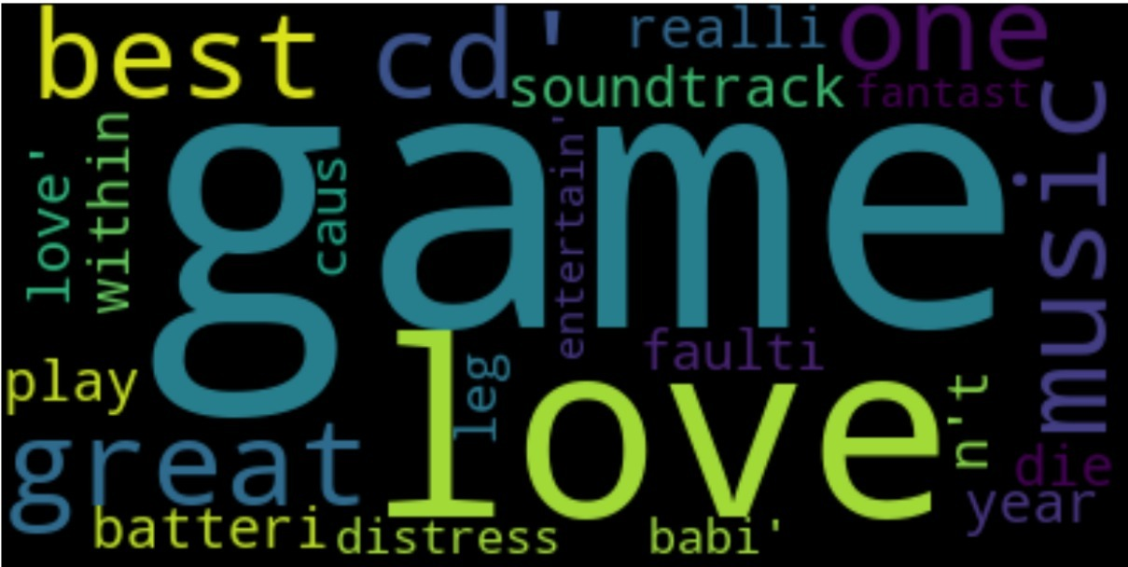
WORDCLOUD FOR CLEANSED TEXT
Through these wordclouds we can see which words are coming the most from the size of it.
The bigger the size of word in the wordclouds the more it is coming in the reviews.

Slide 21
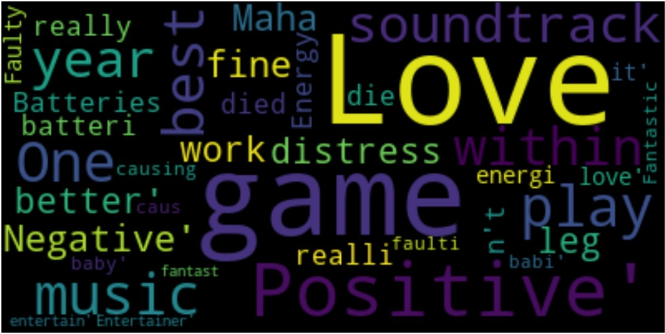
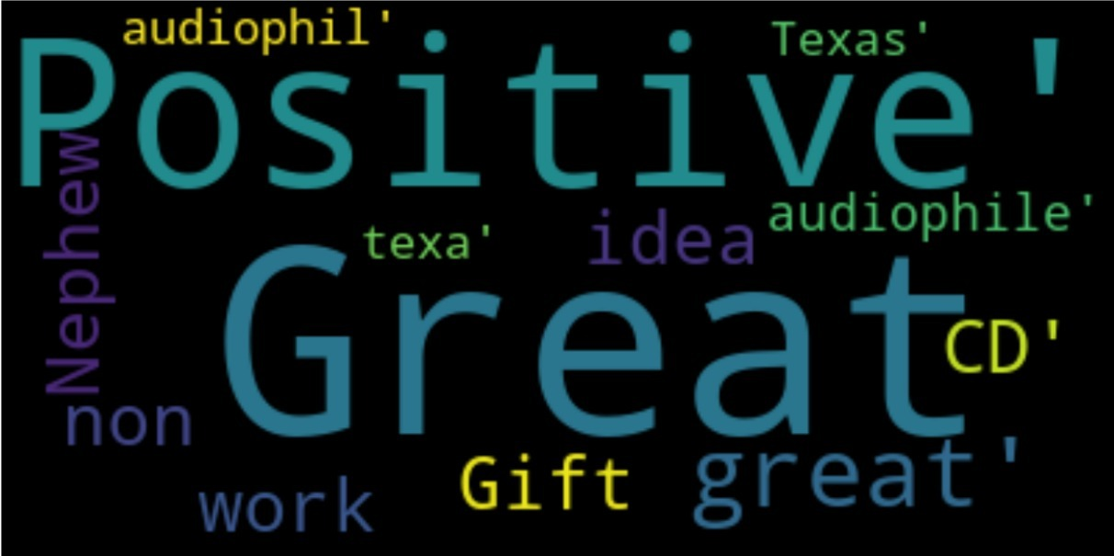

WORDCLOUD FOR CLUSTERS
CLUSTER 1
CLUSTER 2
CLUSTER 3
Through these wordclouds we can see which words are coming the most from the size of it.
The bigger the size of word in the wordclouds the more it is coming in the reviews.

Slide 22


